Slide 1
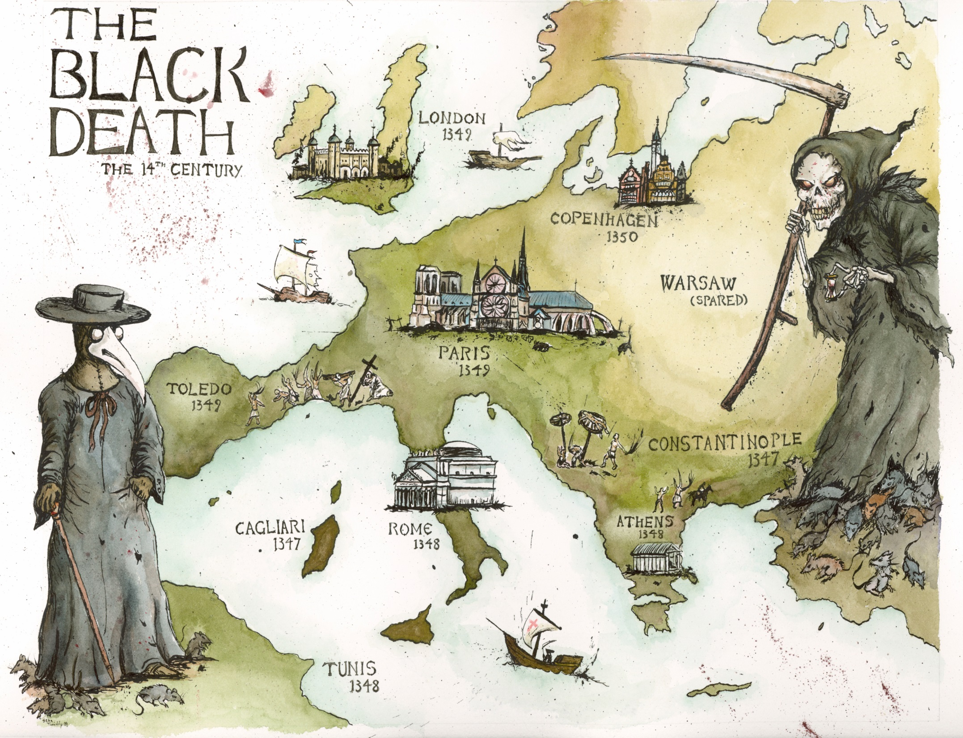

Slide 2


BUBONIC PLAGUE: THE FIRST PANDEMIC
The impact of the bubonic plague epidemics of the past still echo across the centuries, reminding us of the devastation that disease can inflict on communities.

Slide 3
LEARNING INTENTION:
Learn about Medieval Medicine and the bubonic plague
SUCCESS CRITERIA:
Can describe what medieval medicine was like
Can outline what the bubonic plague was

Slide 4

Watch the video – get ready to answer some multiple choice questions at the end!
Notes:
https://www.youtube.com/watch?v=ySClB6-OH-Q

Slide 5
Questions
What caused the Black Death?
The smallpox virus
The influenza virus
Bubonic plague bacterium
The tuberculosis bacterium
No one knows

Slide 6
Questions
What caused the Black Death?
The smallpox virus
The influenza virus
Bubonic plague bacterium
The tuberculosis bacterium
No one knows

Slide 7
How was the Black Death likely spread?
From person to person
By contaminated food
By mosquitos
By rats and their fleas

Slide 8
How was the Black Death likely spread?
From person to person
By contaminated food
By mosquitos
By rats and their fleas

Slide 9
The Black Death was the second major epidemic of its kind. What was the first known epidemic of the disease that also caused the Black Death?
a) The Plague of India
b) The Plague of Justinian
c) The Hong Kong Plague
d) The Antonine Plague

Slide 10
The Black Death was the second major epidemic of its kind. What was the first known epidemic of the disease that also caused the Black Death?
a) The Plague of India
b) The Plague of Justinian
c) The Hong Kong Plague
d) The Antonine Plague

Slide 11
What proportion of the affected population was killed by the Black Death?
Less than 10%
About 25%
Over 90%
About 50%

Slide 12
What proportion of the affected population was killed by the Black Death?
Less than 10%
About 25%
Over 90%
About 50%

Slide 13
When did the Black Death initially occur?
14th century A.D
19th century A.D
541 A.D
1904 A.D

Slide 14
When did the Black Death initially occur?
14th century A.D
19th century A.D
541 A.D
1904 A.D

Slide 15
How would you describe the population that existed right before the Black Death in terms of size, availability of food, and general health?

Slide 16
How would you describe the population that existed right before the Black Death in terms of size, availability of food, and general health?
large, not much food available, poor general health, affected by poverty, famine and disease

Slide 17
In what ways could the Black Death have led to improvements in health in surviving populations?

Slide 18
In what ways could the Black Death have led to improvements in health in surviving populations?
Improving the gene pool.

Slide 19
What has DNA analysis revealed about the Black Death?

Slide 20
What has DNA analysis revealed about the Black Death?
That it is the same strain as the modern strain prevalent today. People who died suffered from poverty, famine and poor general health.

Slide 21
What we will learn…
Origins
Symptoms and Causes
How it was spread – Trade Routes
Impacts on Society

Slide 22
Medicine and the Church
But before we start to look at the origins of the pandemic, we need to establish an understanding of what medicine was like during the Middle Ages…

Slide 23
Notes:
https://www.youtube.com/watch?v=fuEuaSmDOec

Slide 24
Notes – for your HASS books
The Roman physician Galen coined the term ‘plague’ to describe any quickly spreading fatal disease. Epidemics of all kinds have been described as plagues, but the bubonic plague is a very specific disease that first spread around the world in the 1300s.
Bubonic plague is a highly infectious disease spread by fleas that bite their hosts (usually rats and humans) and introduce the bacteria that cause the disease into their host’s bodies.
Infectious diseases like the bubonic plague that spread rapidly among a community or region within a short period of time are called epidemics.
The Black Death is the name given to the first wave of the plague that swept across Europe in the 1300s.
It is called a pandemic because it spread across many countries and affected many populations.

Slide 25
MATCH UP THE KEY WORDS WITH THE CORRECT DEFINITION
.
Key word | Meaning
Symptom | Working out what disease /illness a person has after examining them.
Diagnosis | A set of written instructions to help someone get better. If it is a medicine, it will tell people how to use a medicine.
Prescription | Signs of how a person is being affected by a disease / illness.

Slide 26
MATCH UP THE KEY WORDS WITH THE CORRECT DEFINITION
.
Key word | Meaning
Symptom | Working out what disease /illness a person has after examining them.
Diagnosis | A set of written instructions to help someone get better. If it is a medicine, it will tell people how to use a medicine.
Prescription | Signs of how a person is being affected by a disease / illness.

Slide 27
http://broughttolife.sciencemuseum.org.uk/broughttolife/themes/diseases/black_death

